Slide 2
Chapter 10 Crowded Health
Selecting health service providers
Health service provision
Health command

Slide 3
Health providers
What do you need?
Are there local guidelines or legal requirements?
What is the health risk assessment?
How much will it cost to get it right?
How much will it cost if you get it wrong?
What is available?
Local health, hospital and ambulance services
First aid providers - beware the cheapest option…
Medical teams – onsite doctors & nurses?
Who can you ask to know if they’re reliable?
If multiple providers, clearly agree on health plan & responsibilities

Slide 4
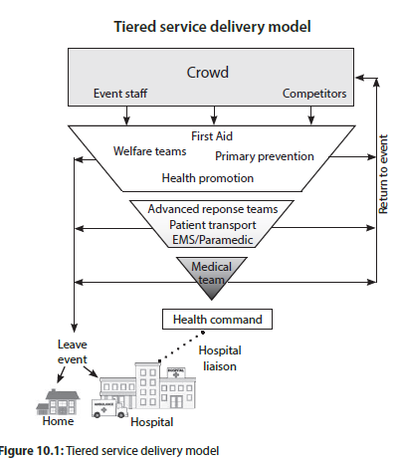

Slide 5
Health COMMAND
Who is responsible for what?
Patient care
Patient transport
Legal requirements
Liaison – event managers, ambulance services, hospitals
Develop an integrated health plan
Include all providers of health care (first aid, ambulance, medical)
Where will resources be located?
How does this fit with the rest of the event plan?
Clearly allocate responsibilities before event day
What is the escalation plan?

Slide 6
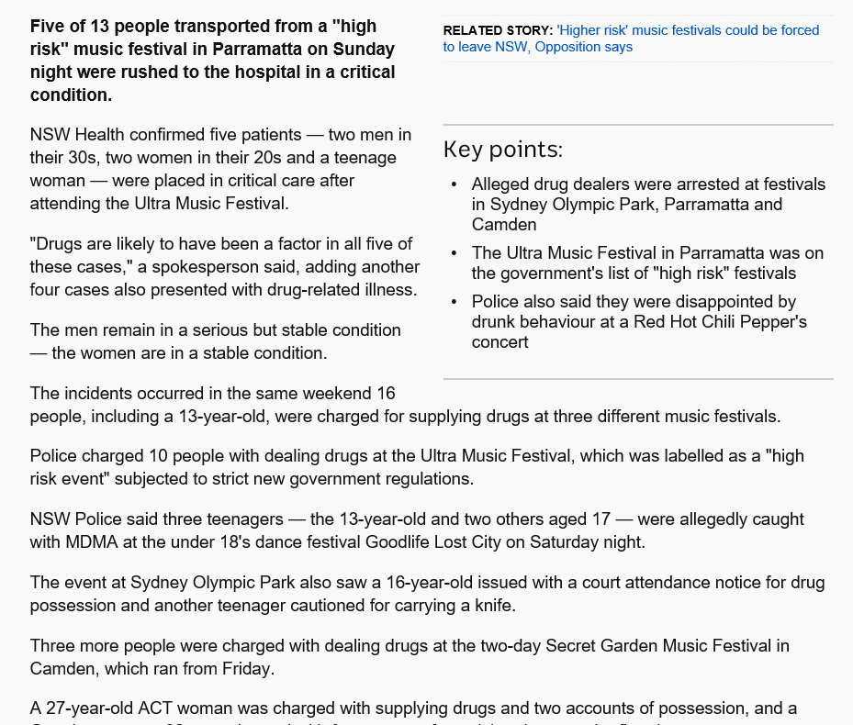

Slide 7
Event day Health IPO cycle
Inputs
Crowd: size, behaviour, trends, security intelligence
Event: weather, hazards, incidents, patient presentation trends
Process
Event Management Team & Health Provider(s) continually assessing inputs & mitigation requirements
Output
Clinical treatment – resuscitation, stabilisation, temporary, definitive
Patient disposition – return to event, home, hospital
Whole of event response, including mobilising additional resources if needed

Slide 8
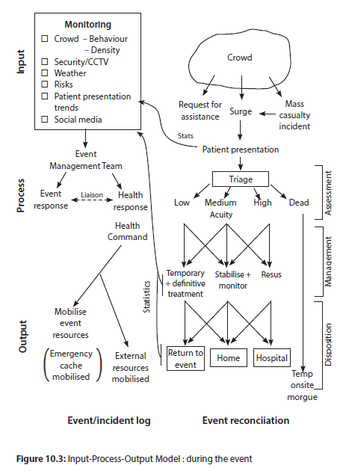

Slide 9
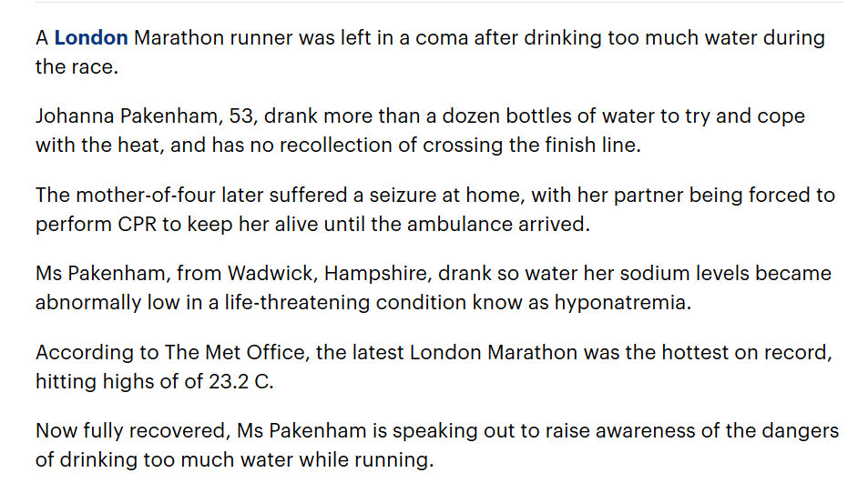

Slide 11
